Slide 1

AI-Based Freelance-Startup System Progress Presentation
Week 06

Slide 2

01 Project Positioning
02 Weekly Progress
2.1 Platform Architecture
2.2 AI & Intelligent Layer
03 Planning and Next Steps
Contents
CATALOGUE

Slide 3


01 Project Positioning

Slide 4
Current Phase
C
Phase 1: Intelligent Foundation
Focus: System Design and Core Architecture
Goal of Week 06: Link all components together to get a real app

Slide 5

Current Phase
Phase Tasks:
Database Modeling
AI Recommendation Tool (Candidate Match)
Profile Analyzer Tool
AI Predictive Tool
Selection and Mission Update
Mission Deployment
Application Tracking System
Profile Engineering and Authentication
Phase Tasks:
Database Modeling
AI Recommendation Tool (Candidate Match)
Profie Analyzer Tool
Selection and Mission Update
Mission Deployment
Application Tracking System
Dual-Sided AI Match Alerts
Profile Engineering
Performance Score (Freelancer Side)
Contract Generation
Sign-in / Sign-up (JWT Authentication)

Slide 6
Weekly Objective
1
Integrate all Phase 1 components into a fully functional system (main objective).
2
Launch Phase 2 and Phase 3 concurrently to accelerate overall development.

Slide 7

02 Weekly Progress

Slide 8
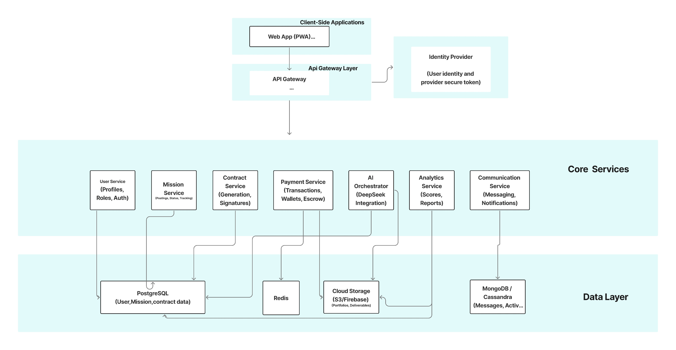
Project Architecture

Slide 9
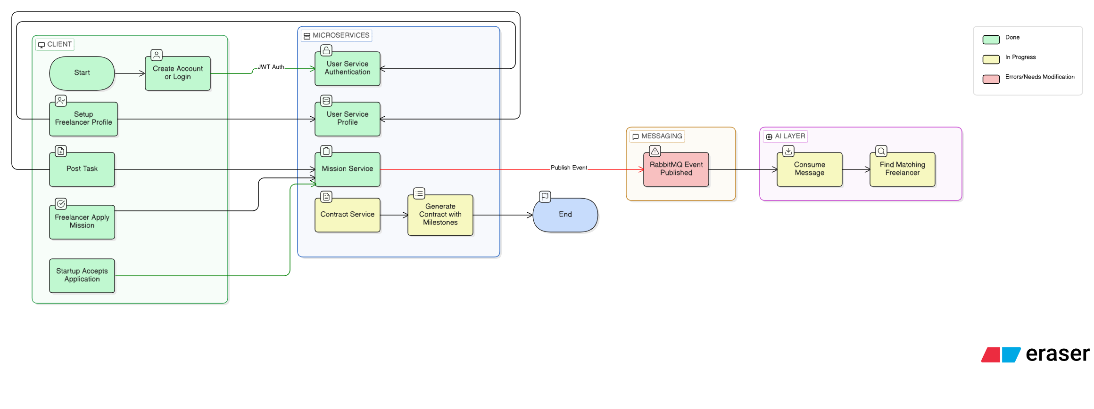
Project Architecture (Phase 01)

Slide 10



Project Architecture (Phase 01)
Done
Incompleted
Planned

Slide 11
Project Architecture (Phase 01)
Phase Tasks:
Database Modeling
AI Recommendation Tool (Candidate Match)
Profie Analyzer Tool
Selection and Mission Update
Mission Deployment
Real -Time notification system
Profile Engineering
Performance Score (Freelancer Side)
Contract Generation
Done
Incompleted
Planned

Slide 12
2 AI and Intelligent Layer
2.1 Integrated Tools
1. Freelancer Tools
search freelancer
get freelancer profile
2. Company and Mission Tools
get company profile
search mission
get mission details
3. AI Matching and Analysis
calculate compatibility score
find best matching mission get matching missions
4. Advanced Deep Analyzers
analyser for freelancer profile

Slide 13
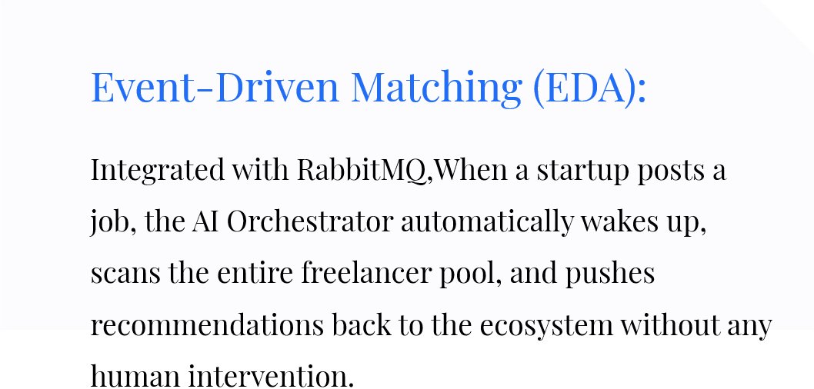
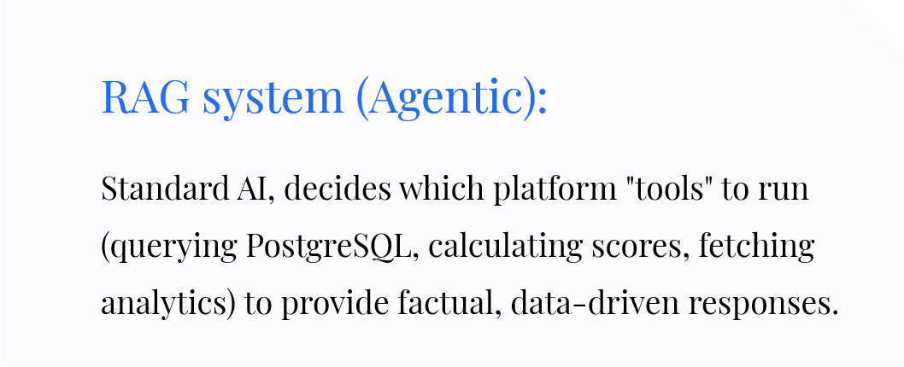
2. AI and Intelligent Layer
2.2 Architecture and Methodology
Weighted Compatibility Scoring:
It uses a multi-dimensional scoring algorithm that evaluates candidates based on: * Skill Overlap and Proficiency: (35%) * Rate Alignment: (25%) * Experience Level: (25%) * Success Rate/History: (15%)

Slide 14
2. AI and Intelligent Layer
2.2 Architecture and Methodology
Automated Matching Workflow :
1. Event Trigger: A Company publishes a mission → `mission-service` emits a `mission_published` message to RabbitMQ. 2. Ingestion: `worker.py` receives the message and fetches the full mission details (skills, budget, requirements). 3. Discovery: The service queries the database to find freelancers whose skills overlap with the mission requirements. 4. Scoring: Each potential candidate is passed through the AI Scorer (`database.py`) to calculate a match percentage (0-100%). 5. Recommendation: Candidates with a score above 20 are sorted and sent back to RabbitMQ. 6. Notification: The platforms' WebSocket service picks up these matches and notifies the Freelancer: "We found a mission that fits your profile!"
Key Technologies :
* FastAPI: High-performance Python web framework. * RabbitMQ (aio-pika): Asynchronous message brokering for the event-driven worker. * PostgreSQL: Primary data source for the matching engine. * Llama 3 : Large Language Models used as the reasoning core

Slide 15
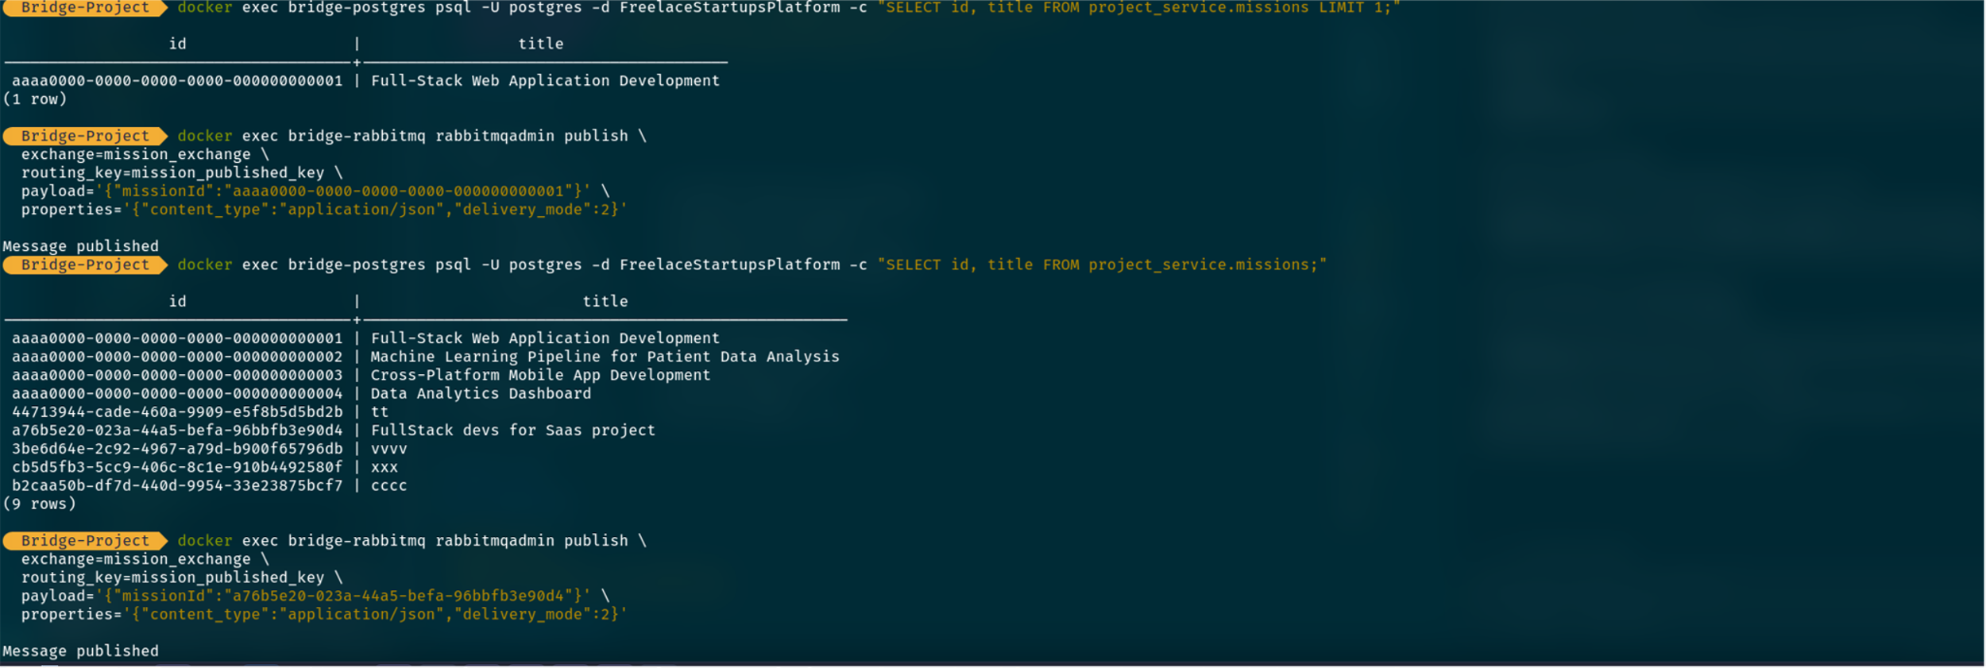
2. AI and Intelligent Layer
2.3 Matching Test Screenshots

Slide 16
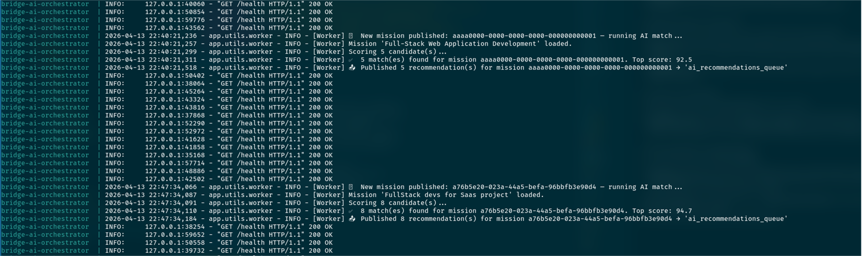
2. AI and Intelligent Layer
2.3 Matching Test Screenshots

Slide 17

03 Planning and Next steps

Slide 18
Plan for the Next Week
1
Integrate all Phase 1 components into a fully functional system (main objective).

Slide 19

Thank you

